Slide 1
Adaptive Artificial Intelligent
QA System
Group - 17-107

Slide 2
Introduction

Slide 3
A QA system for the growing information problem
High rate of information growth
QA system that can understand a given corpus.
Allow the user to ask questions in natural language form
Produce answers in natural language form
The high rate of growth of data means humans cannot keep up. A question answer system should be capable of operating in any domain.

Slide 4
Corpus
Pre-Processing

Slide 5
How?
Current dataset are of Q&A pairs.
Following steps needs to be done for the dataset.
Shuffle
Batch

Slide 6
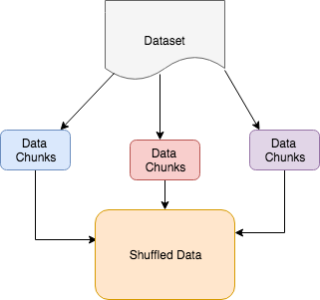
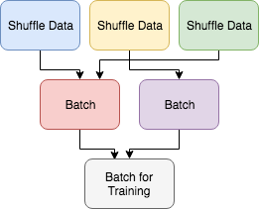
Why Shuffling? Why Batching?

Slide 7
Improvements
Plug medical corpus to existing implementation to support medical domain.
In depth pre-process of the corpus to support the current implementation.
Automating the ‘pluggability’ of datasets into the system

Slide 8
Model Creation using LSTM

Slide 9
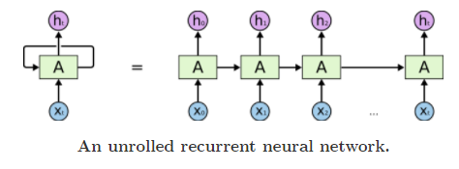
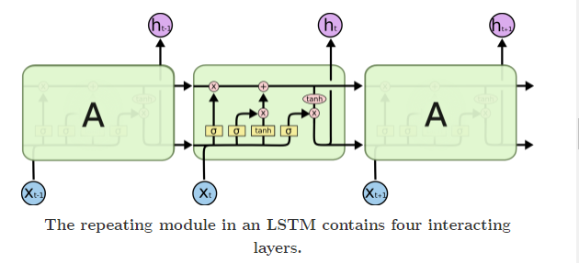
Why LSTM?
“the clouds are in the sky” vs “I grew up in France… I speak fluent French.”
LSTMs are a special kind of RNN, capable of learning long-term dependencies
Notes:
We need our network to remember the past in order to answer the questions, but default RNNs can't handle this issue in the practical environment. LSTM is a special type of network built to support this problem. It has cell based structure with 4 NN layer in each which have ability to add or remove information.

Slide 10
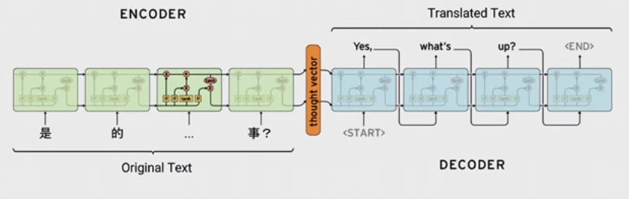
Sequence-to-Sequence Model
A basic sequence-to-sequence model, as introduced in Cho et al., 2014, consists of two recurrent neural networks (RNNs): an encoder that processes the input and a decoder that generates the output.
Notes:
As you can see this image contains the S2S model of Google translator. This is the same model we used in our project and it contains an encoder to receive a word or sequence of words and decoder to generate the output as a word or sequence of words.

Slide 11
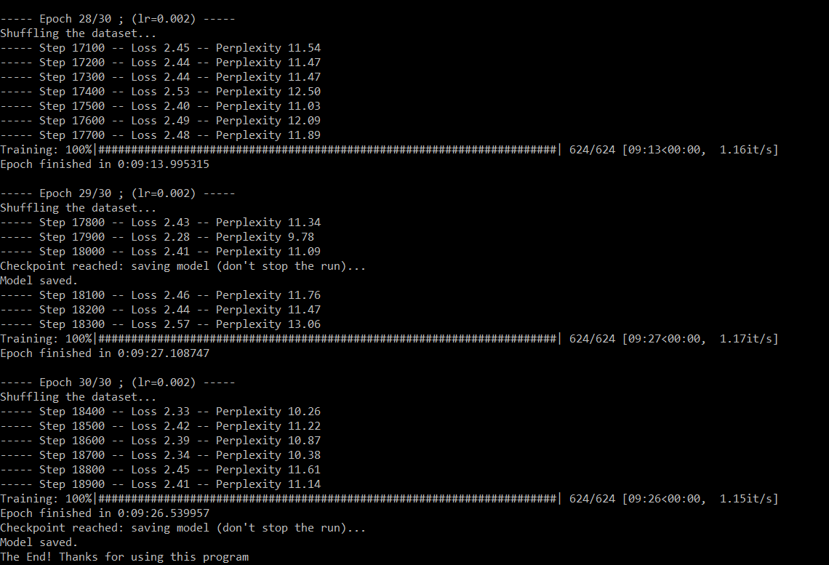
Performance benchmark and limitations

Slide 12
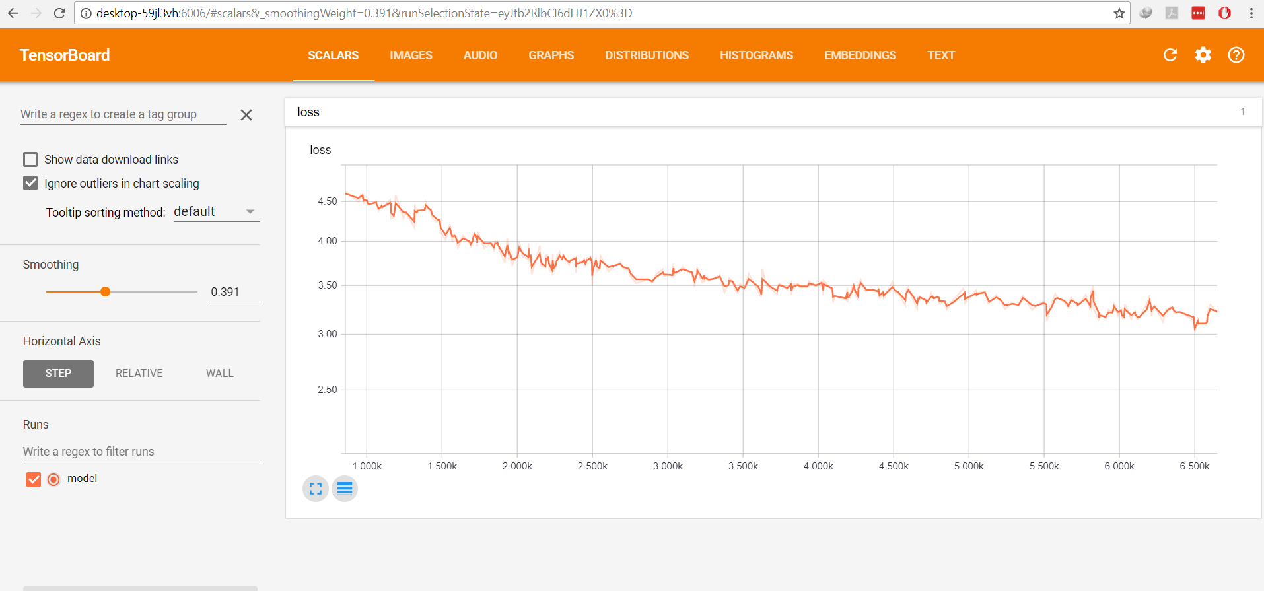
TensorBoard
Notes:
To make it easier to understand, debug, and optimize TensorFlow programs, The lower the Loss, the better a model (unless the model has over-fitted to the training data). The loss is calculated on training and validation and its interperation is how well the model is doing for these two sets. Loss is not in percentage as opposed to accuracy and it is a summation of the errors made for each example in training or validation sets

Slide 13
Question Pre-Processing

Slide 14
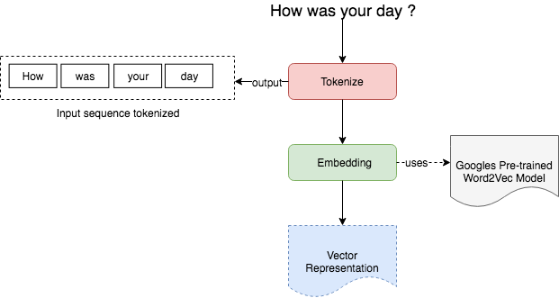
How does Pre-processing work ?

Slide 15
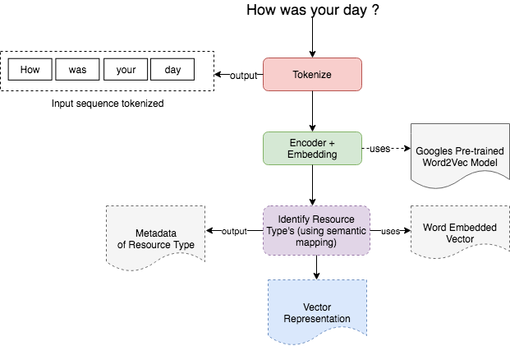
Improvements

Slide 16
Answer Generation

Slide 17
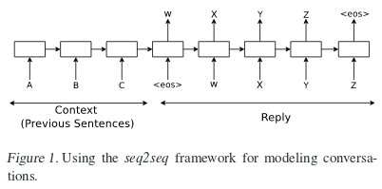
How are we getting answers?
Once the question has been processed, the neural network will map the answer using the sequence to sequence model.
We use a predictive RNN to predict what the next word of the answer sentence will be.
The input sequence is the conversation that has been carried out so far. The output from the model is the reply to the question.
Reference - Vinyals, O. and V. Le, Q. (2015). A Neural Conversational Model. Cornell University Library. [online] Available at: https://arxiv.org/abs/1506.05869
Notes:
Vinyals, O. and V. Le, Q. (2015). A Neural Conversational Model. Cornell University Library. [online] Available at: https://arxiv.org/abs/1506.05869

Slide 18
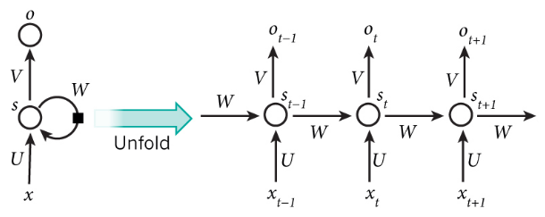
Why are we using a RNN?
Usually deep neural networks are used to identify patterns and are used as predictive models. In this case the DNN must be used as a generative model instead
Limited research done into a system using a recursive auto encoder model. The most promising research has used a RNN.
RNN’s are capable of forming a time series which makes them ideal for forecasting information. A well trained RNN could be capable of predicting the next character in a sequence of characters.
Reference - "Recurrent Neural Networks Tutorial, Part 1 – Introduction to RNNs", WildML, 2017. [Online]. Available: http://www.wildml.com/2015/09/ recurrent-neural-networks-tutorial-part-1-introduction-to-rnns/.
Notes:
"Recurrent Neural Networks Tutorial, Part 1 – Introduction to RNNs", WildML, 2017. [Online]. Available: http://www.wildml.com/2015/09/recurrent-neural-networks-tutorial-part-1-introduction-to-rnns/.

Slide 19
Improvements
Poor performance in answer text generation because of the token based predictive model. A character based model would be better.
The current RNN is trained on a QA dataset. Not a long running conversational dataset. Attempt to train on a better dataset to see improvements.
Notes:
"Recurrent Neural Networks Tutorial, Part 1 – Introduction to RNNs", WildML, 2017. [Online]. Available: http://www.wildml.com/2015/09/recurrent-neural-networks-tutorial-part-1-introduction-to-rnns/.

Slide 20
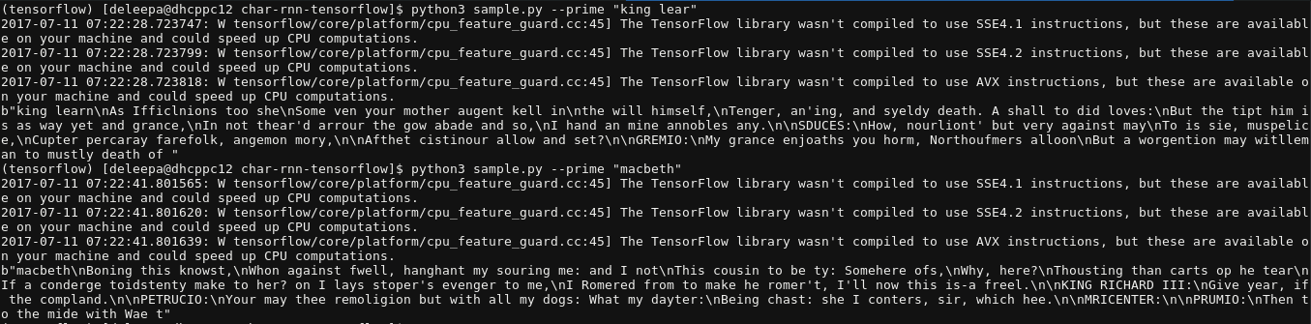
Improvements
Sample output from 128-cell, 2-layer RNN.
Notes:
"Recurrent Neural Networks Tutorial, Part 1 – Introduction to RNNs", WildML, 2017. [Online]. Available: http://www.wildml.com/2015/09/recurrent-neural-networks-tutorial-part-1-introduction-to-rnns/.

Slide 21
Productising

Slide 22
Productising the system
Focus on easy instance deployment by using containerization techniques (using Docker)
Interfaces decoupled from QA engine
Automating the ‘pluggability’ of datasets into the system by using automation scripts for formatting the dataset. Possibility of having an easy to use web interface for this task.
Identification of important aspects of target markets
Availability of data in text format
Data collected over at least 3 years
Heavy use of natural QA format, such as call center operations

Slide 23
Appendix

Slide 24
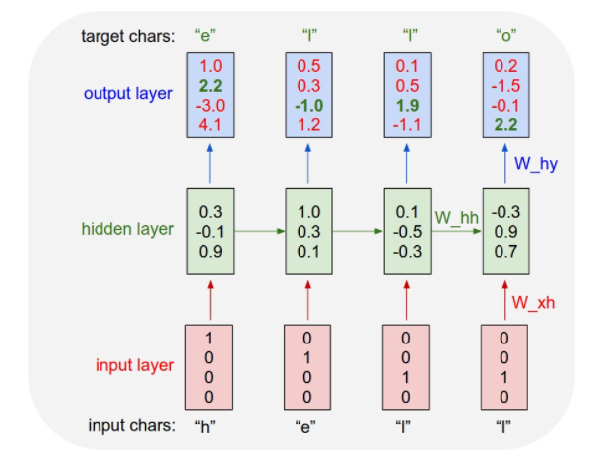
Char-RNN
The following diagram depicts a RNN that is being trained on a language model of four letters (‘E’, ‘H’, ‘L’, ‘O’) to generate the word ‘hello’
This can be extended to a vocabulary of entire words.

